Slide 1
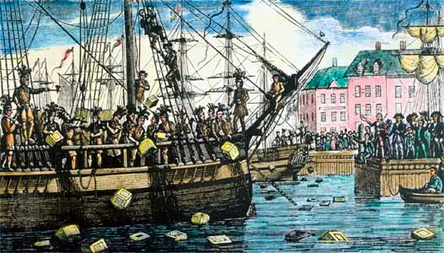
The Boston Tea Party

Slide 2
KWLS CHARTS
GOOD AFTERNOON, STUDENTS!
Please use the first 5 minutes of class to fill out 1 “K” and 2 “W’s” on your KWLS charts about…
THE BOSTON TEA PARTY.

Slide 3
SCHOOL HOUSE ROCK
“No More Kings”
http://www.youtube.com/watch?v=t-9pDZMRCpQ
Based on “No More Kings”
Do you think the Colonists were justified in doing what they did?
Or should the Colonists have paid taxes to the King?

Slide 4
Causes of the Boston Tea Party
Colonial Frustrations
Townshend Acts
Tea Act of 1773
Colonists felt that if they accepted British Tea then they were accepting the Tea Act of 1773 and therefore were accepting parliament’s taxation without representation.
British tea ships refused to leave the Boston harbor without unloading the tea
Virtual Representation vs. Direct Representation

Slide 5
Causes of the Boston Tea Party
British Finances and perception
British population could not afford to pay any new taxes
Parliament thought they could govern the colonies from afar
British believed Tea was a necessary product for the colonists
Britain was in debt from the Seven Years War or French Indian War (1754-1763)
British East India Company was nearly Bankrupt

Slide 6
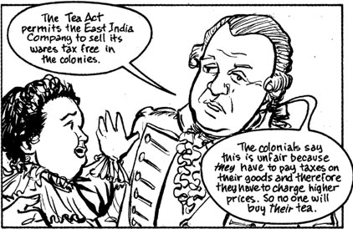

Slide 7
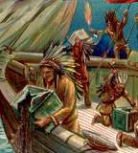
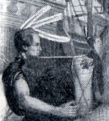
The Events of the Boston Tea Party
Boston Tea Party occurred on Dec. 16, 1773 in Boston Massachusetts
Three ships tied to the wharf in Boston Harbor were boarded at nightfall by colonists disguised as Indians
Eleanor: 115 chest of tea
Dartmouth: 115 chests of tea
Beaver: 112 chests of tea
Lasted roughly 3 hours
Colonists caused a substantial amount of destruction during this time frame

Slide 8
Why Boston?
Boston, a main American port, saw over 5,000 people protest unloading the tea… they were not alone.
Governor Hutchinson refused to grant ships permission to leave the harbor without unloading the tea, which would have prevented any duties (i.e. taxes/tariffs) from being charged to the colonists.
Boston had already shown discontent with British rule leading to previous issues (i.e. the Boston Massacre).
Boston’s American Customs Board oversaw and enforced all Townshend Acts
People of Boston were only ones bold enough to prevent the unloading of the tea by destroying it

Slide 9
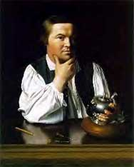
Who Participated?
Only men participated
2/3 under the age of 20
1/3 of participants were skilled artisans (i.e. carpenters, blacksmiths, etc.), meaning they were most effected by business changes (i.e. taxes/tariffs).
The majority were apprentices and common laborers.
Paul Revere

Slide 10
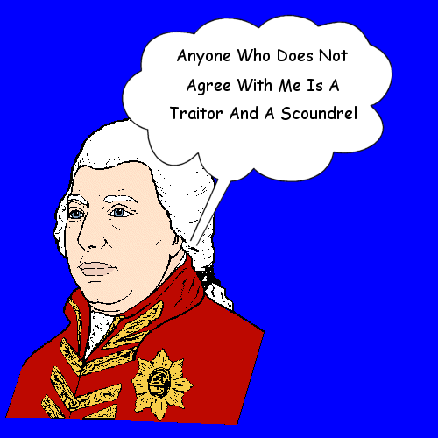
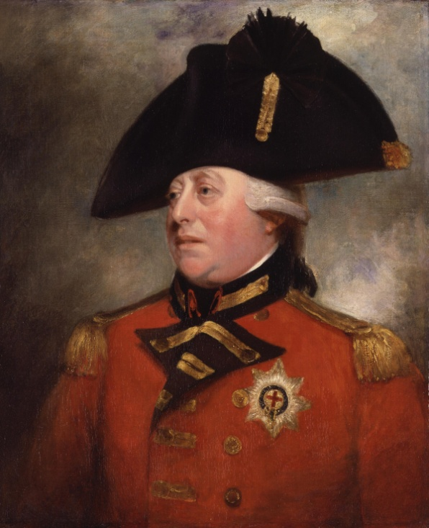
British Reaction
Infuriated by colonists’ act of treason
Thought colonists were being selfish
Colonists needed to be punished for their actions
Introduction of Coercive or Intolerable Acts
King of England - George III (1760-1811)

Slide 11
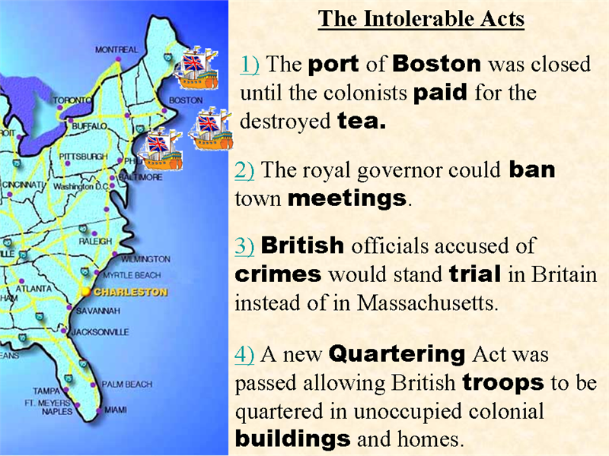
Significance of the Boston Tea Party
Colonists proved they would not accept taxation without representation
Last major colonial act of defiance before start of American Revolution
Introduction of Intolerable Acts
Boston Tea Party was catalyst for American Revolution

